Slide 1
Letian Zhong1 ,Yong Lin1 ,Yian Su1 ,Xianbao Fang1
Improved U-Net Network Segmentation Method
for Remote Sensing Image
이스마일
2022

Slide 2
The key finding or Contribution of this paper
Based on the U-Net model, this paper proposes a new network model for remote sensing image semantic segmentation
In order to fully obtain the global information of multi-scale remote sensing ? To achieve this , the model adds improved ASSP .
Adding a part of skip connection in the coding part , thus alleviating the problem of lost information in upsampling and having a good multi-scale property

Slide 3
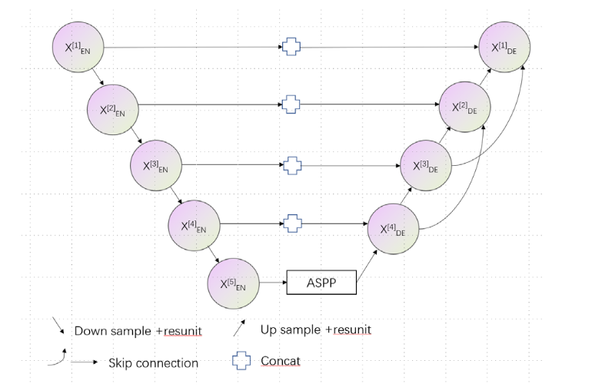
Improved U-Net Network
As can be seen from the diagram , the paper improved classical UNET architecture by describing a new network architecture called ARU-NET , the improvement include of
ResBlock : The residual block is a combination of Batch Normalization , Activation Function (Relu) and convolutional layers and it helps to standardize the data and accelerate the convergence speed .
ASSP(Spatial pyramid pooling) :The ASSP connects the encoding path and the decoding path and it’s also the last layer in the encoding network.

Slide 4
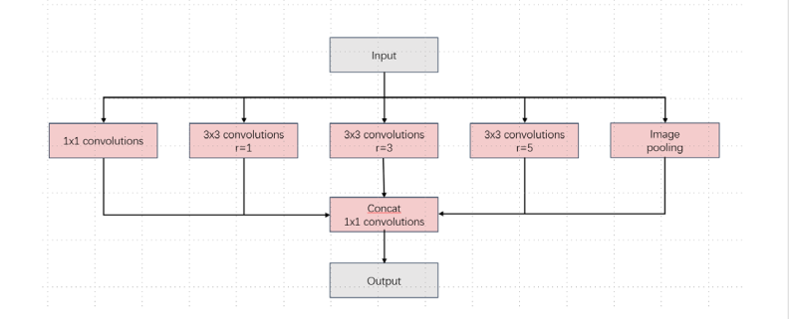
Improved ASPP Module
The traditional pooling operations are usually maximum pooling , average pooling or random pooling in CNN may results of spatial information.
The pyramid pooling module (PPM) and Spatial pyramid pooling (SPP) were developed to address this issue and allow the network to adapt various size of input image
The ASPP module consists of four parallel convolutions with different dilation rates ,1x1 conv block , batch normalization and activation function
The first branch is 1 x1 standard conv and the other three branches perform feature extraction .
the last branch directly pools the input to obtain global features .
Finally the five branches are concatenated and 1x1 standard convolution is performed

Slide 5
Performance index
They use two performance valuation metrics
Average Pixel Accuracy (MPA) : The MPA is calculated by dividing the total number of correctly classified pixels in each class by the total number of pixels in that class and averaging the values across all classes.
Mean Intersection Over Union (MIOU) is standard metric for semantic segmentation and it’s calculated by dividing the intersection of the true value and the predicted value for each class by the union of the same two values , MIOU measures the overall similarity between the predicted segmentation and true segmentation

Slide 6
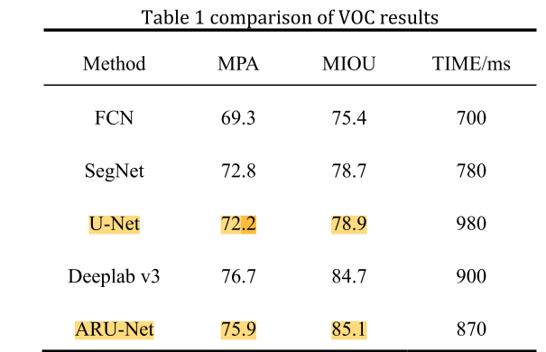
Experimental Results
This section they compared FCN, U-Net and other commonly used semantic segmentation frameworks on VOC test set
The proposed ARU-Net algorithm outperforms the original U-Net model with improvement of 3.7 in MPA and 6.6 in MIOU

Slide 7
Key point that i can take from this paper
Applying ResBlock & ASSP(Spatial pyramid pooling) mechanisms can enhance the feature maps obtained from the skip connections

